Slide 1

K18X001.00 verify CM choke_T1, FFC AMP Cable Burn Report
Prepared by: PE- Phuong
Date: 2022.02.14

Slide 2
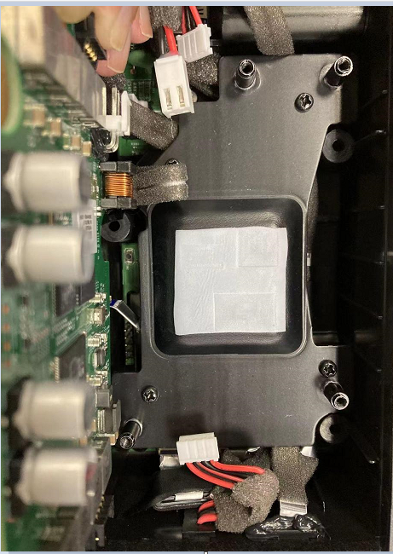
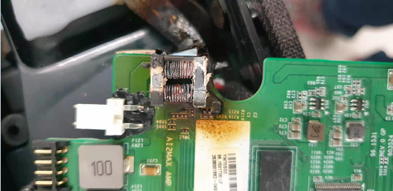
Background Information
1. Background Information
- 2022/02/08 ALT found out 1 pcs K18X001.00 model has CM choke_T1 on AMP board is burned and FFC Amp cable almost melted
2022/02/11, RD: Tom confirm this is a risk of burned CM choke and FFC cable melted.
FFC Amp melted
T1 burned
NG burned
FFC Amp cable inserted between AMP Top board and heat speader
Summary:
-Suspect when assembling the FFC amp cable between AMP Top board and heat speeder when operating for a long time may cause a burn.

Slide 3
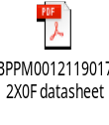
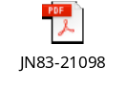
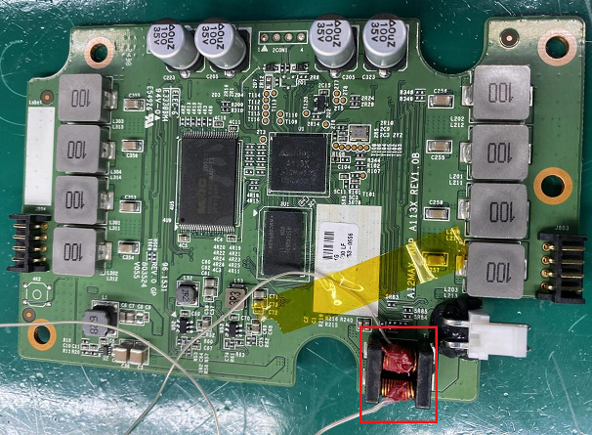
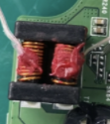
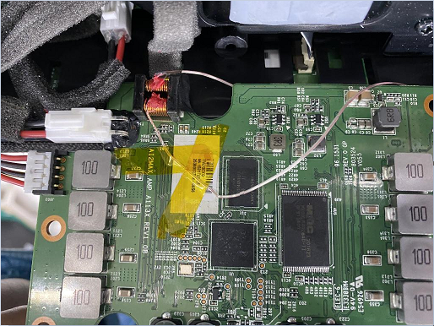
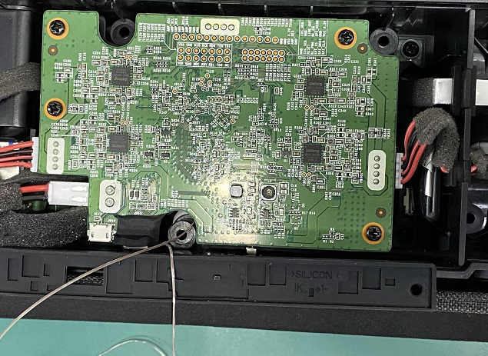
Verify CM Choke, FFC AMP Cable
1. Verify temperature of T1 during operation.
- Check CM choke_T1 (BPPM00121190172X0F) datasheet: Operating Temperature: －40℃ ~ 125℃ (Including self - temp rise)
- Check FFC AMP cable (JN83-21098) datasheet: Operating Temperature: -30℃ ~ 80℃ (Heat Resistance: 85 ℃ , 96H)
Sensor 2
Sensor 3
Assemble temperature sensor
Assemble 96.1531T00 into K18X001.00
Summary:
- Verify check temperature of FFC AMP cable and CM choke by sensor.

Slide 4
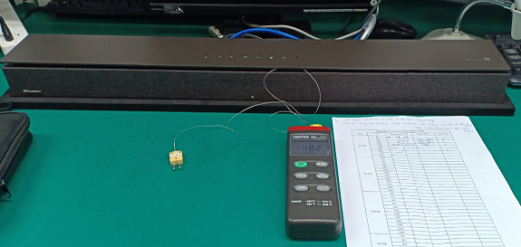
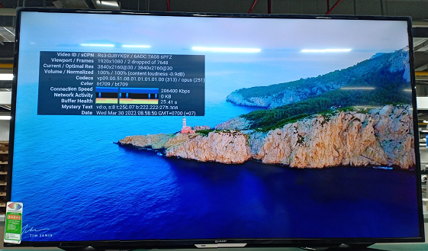
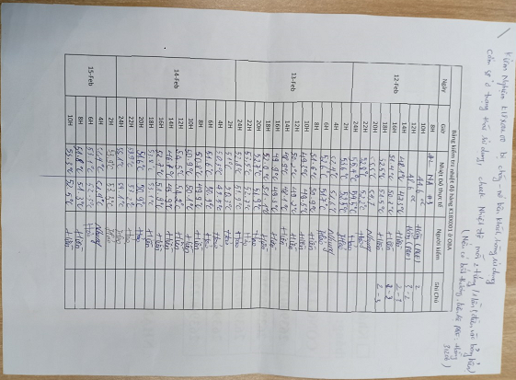
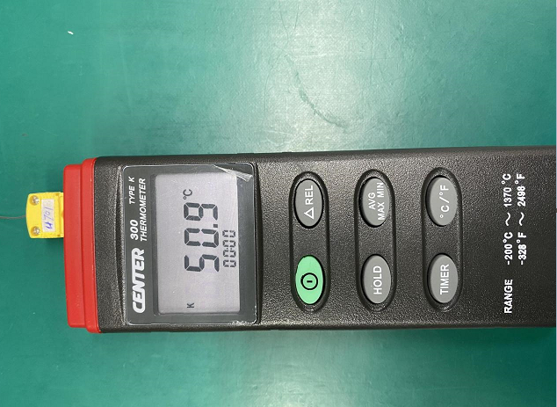
2. Assembly housing and open You Tobe video 4K function during 72 hours.
- Assemble the temperature sensor at T1 location, assemble housing and check temperature of T1 affect to FFC AMP cable while product working.
- Note: Check temperature in 3 day from 02/12 to 02/15 ( 72 hours- 2hours/per time by OP).
Assembly Top Housing
Open youtube video 4K
Check temperature 2H/1 times
Summary:
Assemble the temperature sensor at T1 location, assemble housing and check temperature of T1 affect to FFC AMP cable while product working.

Slide 5
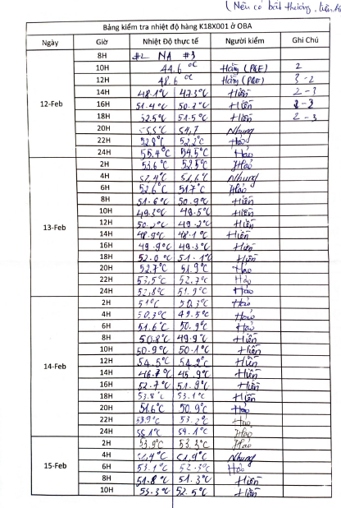

Conclusion
As verify temperature of CM choke_T1, FFC Amp cable by 2 sensor temperature result. T1, FFC AMP cable does not burn.

